Slide 1
ELECTRICAL SCIENCE-1
(15B11EC111)
Unit-7
Electrical Instruments
( Essentials of an Instrument, Permanent Magnet Moving Coil (PMMC) Instruments, voltmeter, ammeter, Ohmmeter, Meter Sensitivity (Ohms Per-Volt Rating); Loading Effect; Multimeter; Cathode Ray Oscilloscope: Construction, Working and Applications. Function Generators )
Lecture-4
Dr. Abhishek Kashyap
Assistant Professor (Senior Grade, JIIT Noida)

Slide 2
Topics to be covered
EXTENSION OF RANGE OF PMMC INSTRUMENTS
SENSITIVITY OF THE METER
LOADING EFFECTS
PROBLEMS
PRACTICE PROBLEMS
REFERENCES
2

Slide 3
Extension of Range of PMMC Instruments
In a permanent-magnet moving coil (PMMC) instrument, the moving coil and the springs used as coil connections have a very delicate design and can carry maximum current of about 10 mA i.e., full-scale deflection (f.s.d.) will occur when about 10 mA current flows through the instrument coil.
If current through the coil exceeds this value (i.e. 10 mA), the coil may be burnt due to excessive heat.
However, in practice, we have to measure large currents and voltages.
In such situations, some means are adopted to increase the range of the instruments.

Slide 4
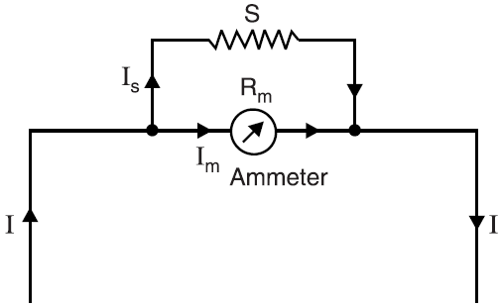
Extension of Range of PMMC Ammeter
The range of a permanent-magnet moving coil ammeter can be extended by connecting a low resistance, called shunt in parallel with the moving coil of the instrument as shown in Fig.
The shunt bypasses most of the line current and allows a small current through the meter which it can handle without burning.
Let
R_{m} = meter resistance
S = shunt resistance
I_{m} = full-scale deflection (f.s.d.) current
I = full range current of the meter
Voltage across shunt = Voltage across the meter
(I – I_{m})S = I_{m} R_{m}
Shunts are made of materials such as manganin having low temperature coefficient of resistance

Slide 5
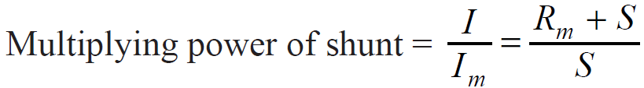
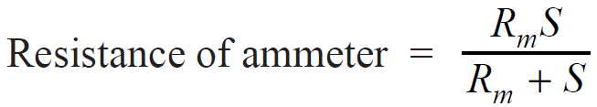
Extension of Range of PMMC Ammeter
Multiplying power of shunt:
It is the ratio of circuit current to be measured to the meter current. The multiplying power of a shunt is constant and indicates the factor by which the meter current must be multiplied to obtain the circuit current.
Resistance of ammeter:

Slide 6
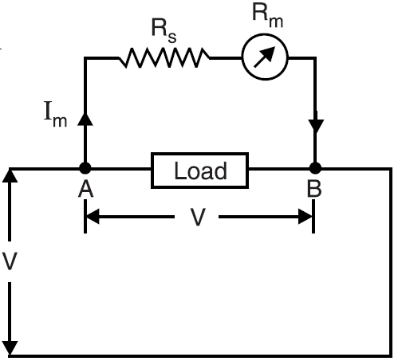
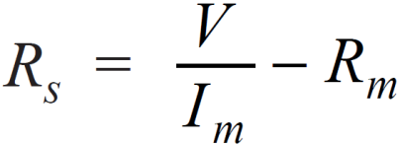
Extension of Range of PMMC Voltmeter
The range of a permanent-magnet moving coil voltmeter can be increased by connecting a high resistance R_{s} called multiplier, in series with it as shown in Fig.
Let
R_{m} = meter resistance
R_{s} = series resistance i.e., multiplier
I_{m} = full-scale deflection current
V = full-range voltage of the meter
Voltage across AB = Voltage across the meter and R_{s}
or V = I_{m}(R_{s} + R_{m})

Slide 7
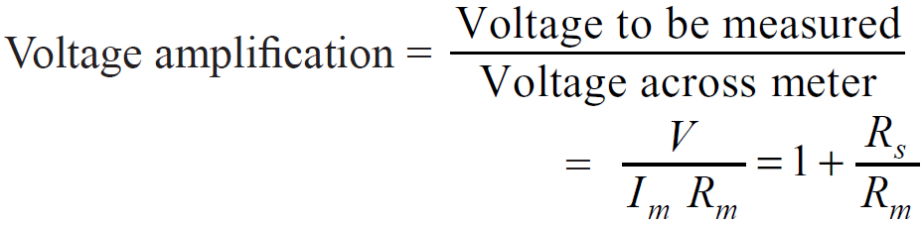
Extension of Range of PMMC Voltmeter
Voltage amplification
Clearly, greater the value of R_{s}, greater is the voltage amplification. For this reason, R_{s} is called voltage multiplier or simply multiplier.
The important requirement of a multiplier is that its resistance should remain constant, i.e. it should have low temperature coefficient of resistance.
Resistance of voltmeter = R_{m} + R_{s}

Slide 8
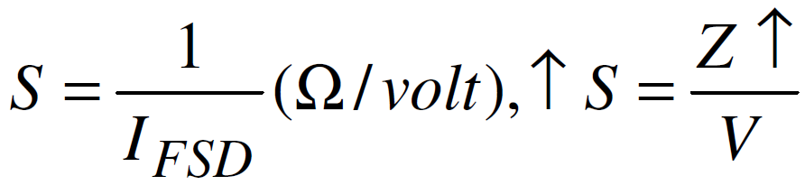
Sensitivity of the meter (S)
It is also called ohms/volt rating of the instrument.
Larger the sensitivity of an instrument, more accurate is the instrument.
It is measured in Ω/volt.
When the sensitivity is high, the impedance of meter is high. Hence it draws less current and loading affect is negligible.

Slide 9
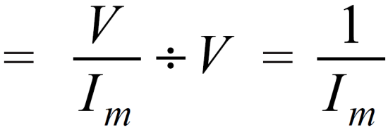
Voltmeter Sensitivity
The resistance offered per volt of full scale deflection by the voltmeter is called voltmeter sensitivity.
Voltmeter sensitivity indicates the internal resistance of the voltmeter.
For example, if the total resistance of the meter is 5000 Ω and the meter is to read 5 volts full scale, then internal resistance of the meter is 1000 Ω per volt i.e. meter sensitivity is 1000 Ω per volt.
Voltmeter sensitivity = Resistance per volt full scale deflection
Sensitivity is the most important characteristic of a voltmeter. If the sensitivity of a voltmeter is high, it means that it has high internal resistance.

Slide 10
LOADING EFFECTS
Under practical conditions, it has been observed that the introduction of any element in a system results invariably in extraction of the energy from the system, thereby distorting the original signal. This distortion may take the form of attenuation, waveform distortion, phase shift, etc., and consequently, the ideal measurements become impossible.
The incapability of the system to faithfully measure the input signal in undistorted form is called loading effect. This results in loading error.
The loading effect may occur on account of both electrical and mechanical elements. These are due to impedances of the various elements connected in a system.

Slide 11
LOADING EFFECTS
Loading effect occurs due to the connection of measuring instruments in an improper way.
Suppose a voltmeter is connected with parallel of a very high resistance. Due to the high resistance of the voltmeter itself, the circuit current changes. This is the loading effect of a voltmeter when they are connected in parallel with a very high resistance.
Similarly, an ammeter has a very low resistance. So if an ammeter is connected in series with a very low resistance, the total resistance of the circuit changes, and in succession, the circuit current also changes. This is the loading effect of ammeters when they are connected in series with very low resistance.

Slide 12
Example
The coil of a moving coil permanent magnet voltmeter is 40 mm long and 30 mm wide and has 100 turns on it. The control spring exerts a torque of 120 × 10^{–6} Nm when the deflection is 100 divisions on full-scale. If the flux density of the magnetic field in the air-gap is 0.5 Wb/m², estimate the resistance that must be put in series with the coil to give one volt per division. The resistance of the voltmeter coil may be neglected.

Slide 13
Solution
Let I_{m} be the full-scale meter current.
Full-scale deflecting torque is
T_{d} = B I_{m} N A = 0.5 × I_{m} × 100 × 0.04 × 0.03 = 0.06 I_{m} Nm
Full-scale controlling torque is
T_{C} = 120 × 10^{–6} Nm ... Given
In the final full-scale position, T_{d} = T_{C}
0.06 I_{m} = 120 × 10^{–6}
or I_{m} = 2 × 10^{–3} A

Slide 14
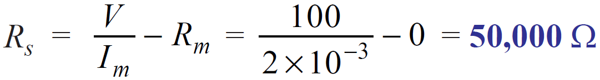
Solution
Full-scale reading required from the instrument is
V = 100 × 1 = 100 volts
External resistance R_{s} to be put in series with the coil is

Slide 15
Example
The meter element of a permanent-magnet moving coil instrument has a resistance of 5 ohms and requires 15 mA for full-scale deflection. Calculate the resistance to be connected
in parallel to enable the instrument to read upto 1A
in series to enable it to read upto 15 V

Slide 16
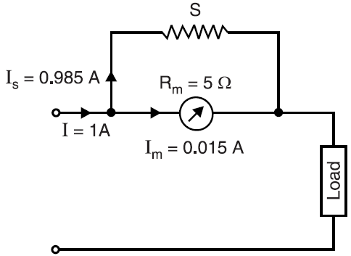

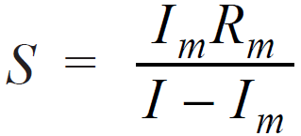
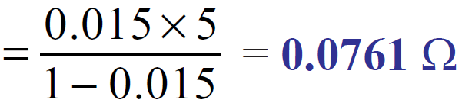
Solution
Meter resistance, R_{m} = 5 Ω
Full-scale meter current, I_{m} = 15 mA = 0.015 A
(i) As Ammeter:
Full-scale circuit current, I = 1 A
Let S ohms be the required value of the shunt
Now,

Slide 17
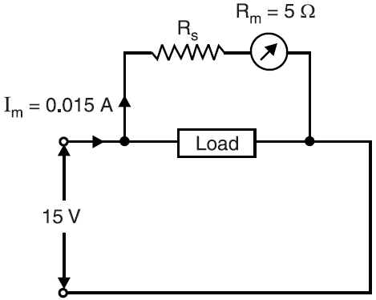
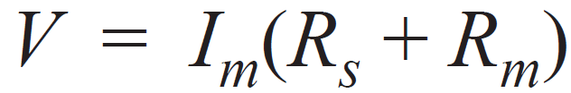
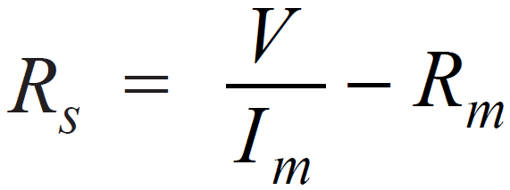
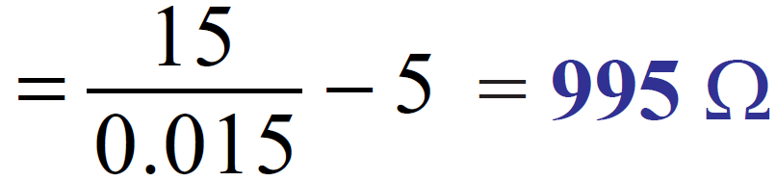
Solution
(ii) As Voltmeter:
Desired full-scale reading, V = 15 volts
Let R_{s} ohms be the required series resistance
Now,

Slide 18
Example
What should be the resistance of the moving coil of an ammeter which requires
2·5 mA for full-scale deflection so that it may be used with a shunt having a resistance of 0·0025 Ω for a range of 0 – 10 A ?

Slide 19
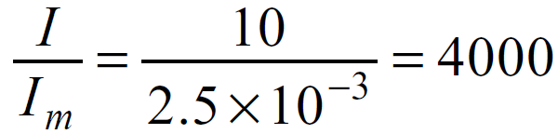
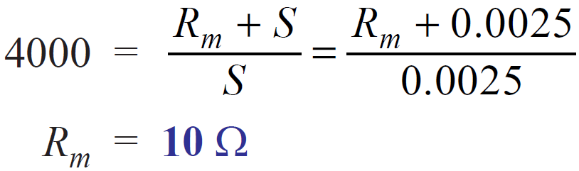
Solution
Multiplying power of shunt
Now,

Slide 20
References
Charles K. Alexander (Author), Matthew N.O Sadiku, “ Fundamentals of Electric Circuits”, 6th ed, Tata Mc Graw Hill, 2019..
D.C. Kulshreshtha, Basic Electrical Engineering, Revised 1st ed, Tata Mc Graw Hill, 2017.
V. K.Mehta, Rohit Mehta, Basic Electrical Engineering, 6th ed, S. Chand Publishing, 2012.

